Slide 1
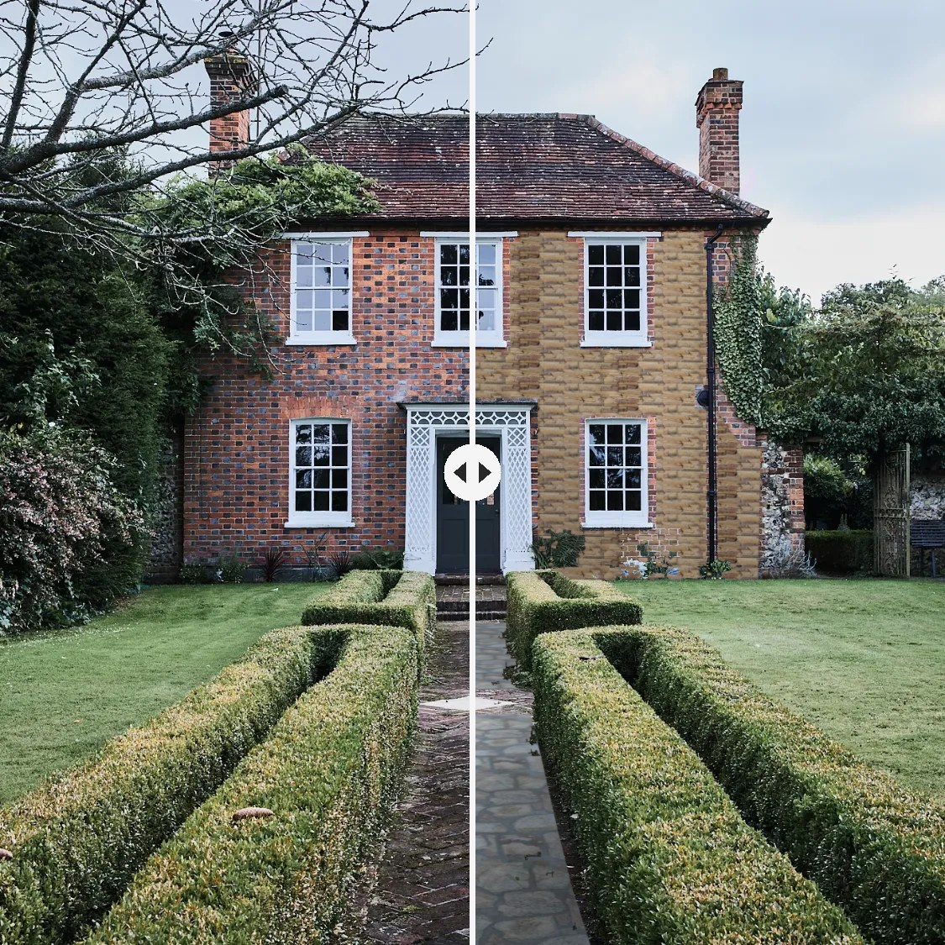
Stone
Visualizer
PERSONAL PROJECT · SEMESTER 4
See real stone on your own house before anything is laid.
Vladi Georgiev · Fontys ICT
Notes:
Hi, I'm Vladi. My personal project is the Stone Visualizer: you take a photo of your house, pick a stone, and see it on your own walls. The image on the right is one house, half before and half after.

Slide 2
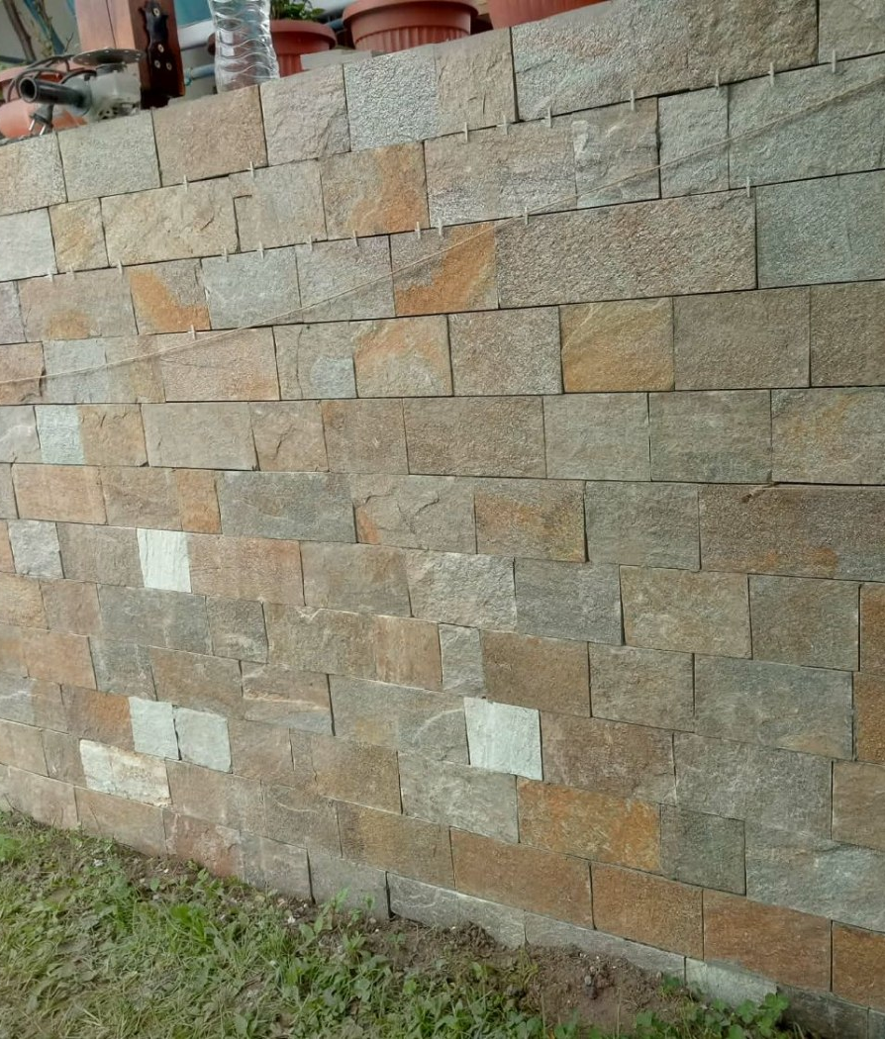
Clients can’t picture the result.
THE PROBLEM
Loose samples and photos of other houses don’t help them decide.
Photo: a finished job from my father’s work
Notes:
The idea comes from my dad's work. Almost every client struggles with the same thing: they see a loose sample or someone else's house and still can't imagine it on their own wall. Decisions get delayed or changed halfway through the job.

Slide 3
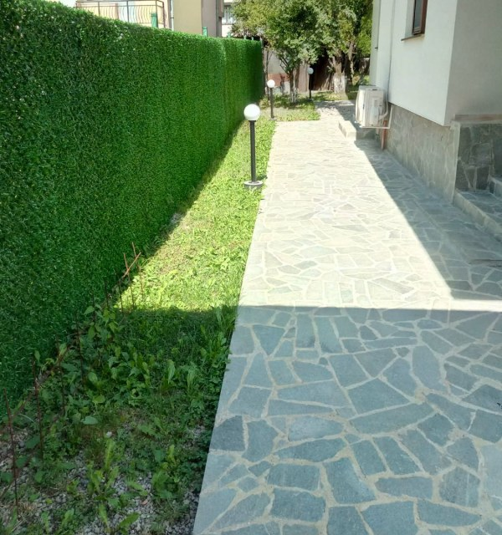
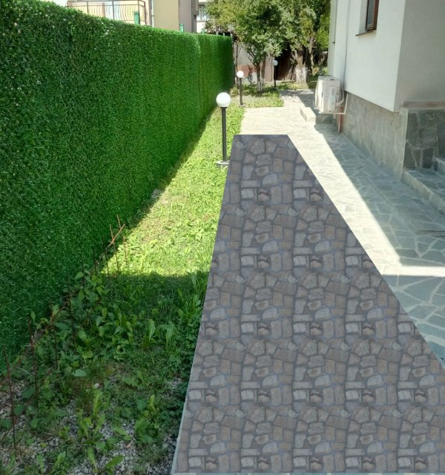

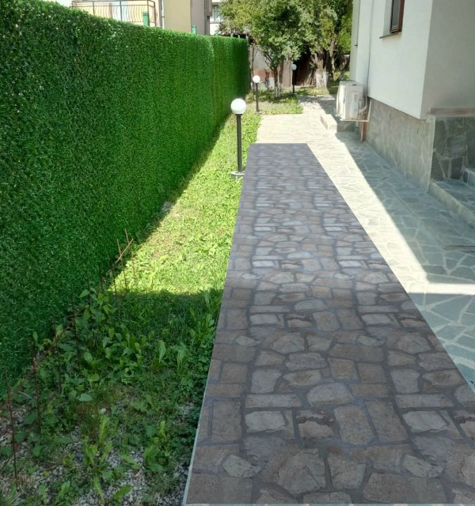
Photo in. Real stone out.
HOW IT WORKS
1 Photo
2 Flat paste
3 Perspective
4 Light and shadow
Notes:
Four steps. Mark the surface, then a plain paste looks like a sticker. Perspective makes the stones get smaller with distance. Finally the photo's own light and shadow go back on top, so the house shadow stays where it was. Every stone comes from a photo of a real finished job, no generative AI.

Slide 4
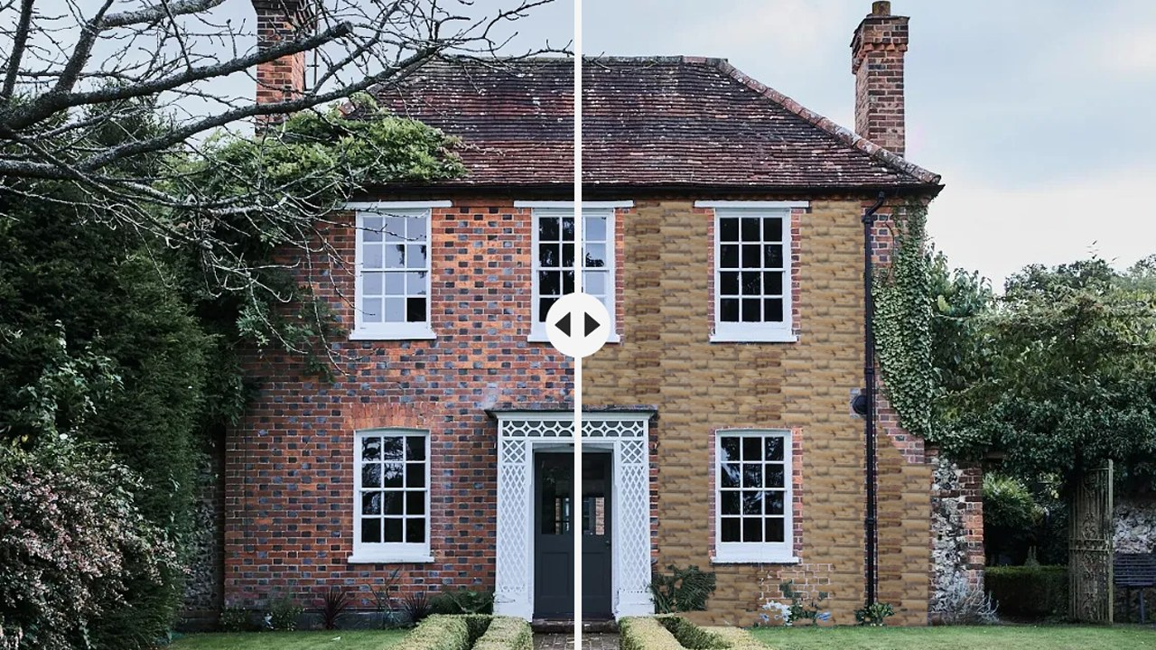
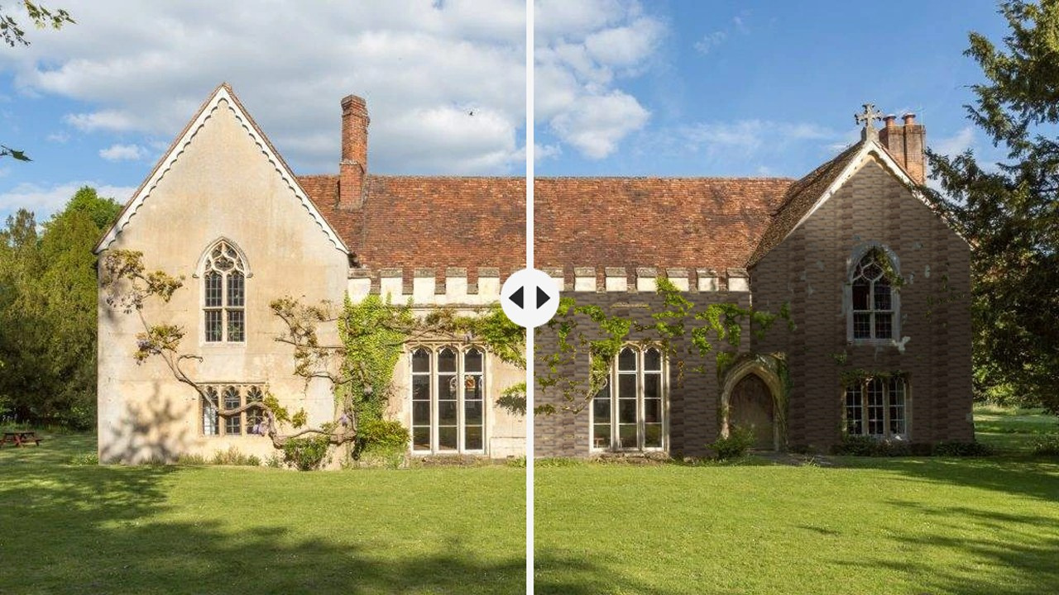
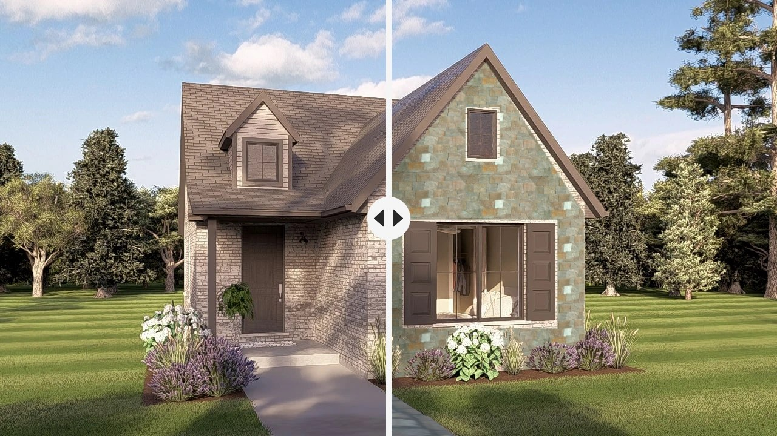
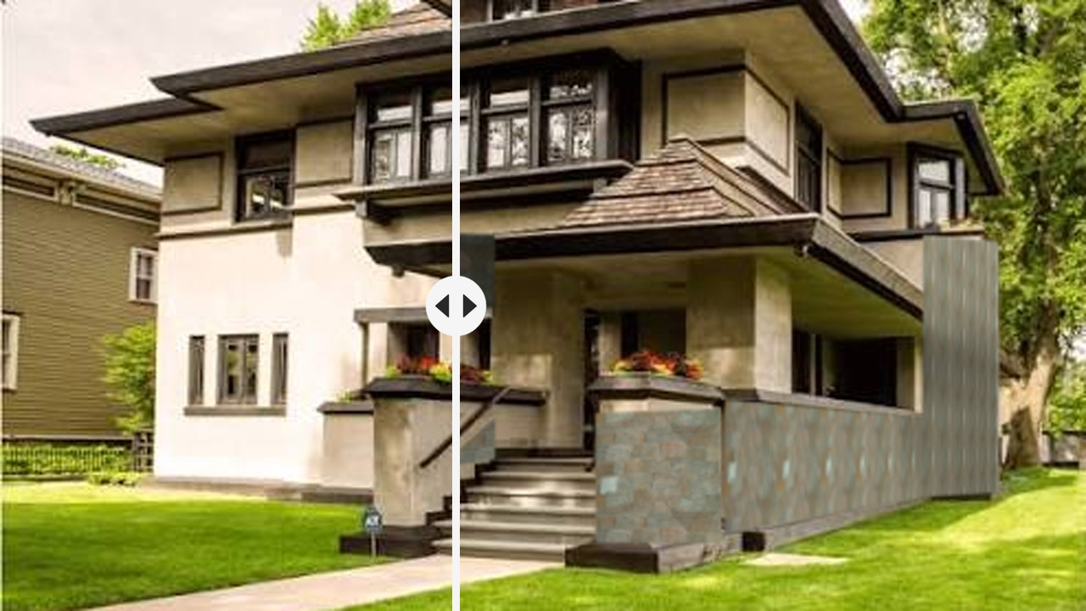
Pick a stone. See it on the house.
THE SHOWCASE
Brick house
Old rectory
New cottage
Prairie house
4 houses, 6 stones, each cut from a photo of a finished job.
Try it live
Notes:
All four houses from the showcase, each split down the middle: left is the original photo, right is with the stone. Windows, doors and plants stay in front of the stone. Click "Try it live" to open the showcase and do it live.

Slide 5
Learned, and what’s next
LEARNED
LEARNED
NEXT
0.99:1
Light
SAM2
The perspective maths measured a real square of tiles almost exactly.
Keeping the photo’s shadows makes it believable, more than a perfect outline.
Find the wall automatically, then train on my dad’s job photos.
Notes:
Two things I learned: the perspective maths holds up, a 2 by 2 patch of real tiles came out at 0.99 to 1. And realism comes from keeping the light and shadow, not from a perfect outline. Next step: automatic wall detection with SAM2, then fine-tuning on my dad's photo archive.

Slide 6
Questions?
Which preview looked least real to you?
Notes:
Ask for feedback: Would a customer accept dragging 4 corners, or must it be fully automatic? Which preview looked least real? What should come next: automatic detection or better rendering?

